Slide 1
IPFS (InterPlanetary File System) A new Frontier for Next-Gen IoT Communication
PROJECT BY:
MANOJ KUMAR T
211121101603
DEPARTMENT OF IT
GUIDED BY:
Mr.N.JEYSANKAR
DEPARTMENT OF IT
CO-ORDINATED BY:
Dr.M.KIRUTHIGA DEVI
DEPARTMENT OF IT

Slide 2
ABSTRACT
The Internet of Things (IoT) has witnessed an exponential growth in recent years, with billions of interconnected devices generating massive amounts of data. Traditional centralized approaches to IoT communication, relying on cloud-based platforms and centralized servers, have faced challenges in terms of scalability, security, and privacy. To address these limitations, this paper explores the potential of the InterPlanetary File System (IPFS) as a decentralized and secure solution for IoT communication. IPFS is a distributed file system that utilizes content-addressing and peer-to-peer networking to create a robust and resilient infrastructure for data storage and sharing. By leveraging IPFS, IoT devices can establish direct communication channels, eliminating the need for intermediaries and reducing the risk of single points of failure. Moreover, IPFS provides a decentralized storage mechanism that ensures data integrity and prevents tampering. This paper presents a comprehensive overview of IPFS and its key features, highlighting its suitability for IoT communication. By leveraging IPFS, IoT systems can become more resilient, secure, and scalable, paving the way for a more decentralized and interconnected future.

Slide 3
Introduction of the project
It’s an open source project on a mission to develop a distributed IOT system. It feels like BitTorrent + Git smashed together to allow anyone running the IPFS daemon to access each other’s files in a peer-to-peer (P2P) fashion.
Pubsub basically lets you “subscribe” to a channel or topic allowing you to receive messages from other devices that “publish” messages to that same channel or topic.
Just as easily automate the toggling of this LED to fully complete automated decentralised manufacturing factory

Slide 4
Problem Statement
Current Challenges in Traditional IoT Systems:
Single Points of Failure
Data Privacy Concerns
Scalability Limitations

Slide 5
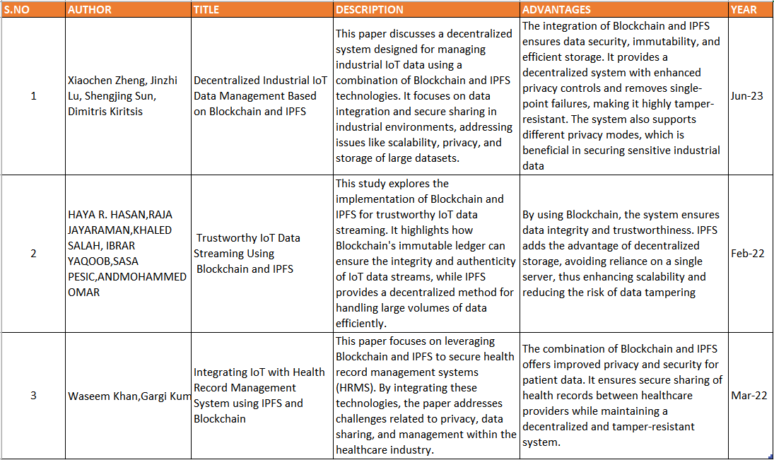
Literature Survey

Slide 6
Centralized Data Storage
Security and Privacy Concerns
Inefficient Data Management
Existing Work

Slide 7
Decentralized Data Storage
Secure and Immutable Data
Efficient Data Management
Proposed Work

Slide 8
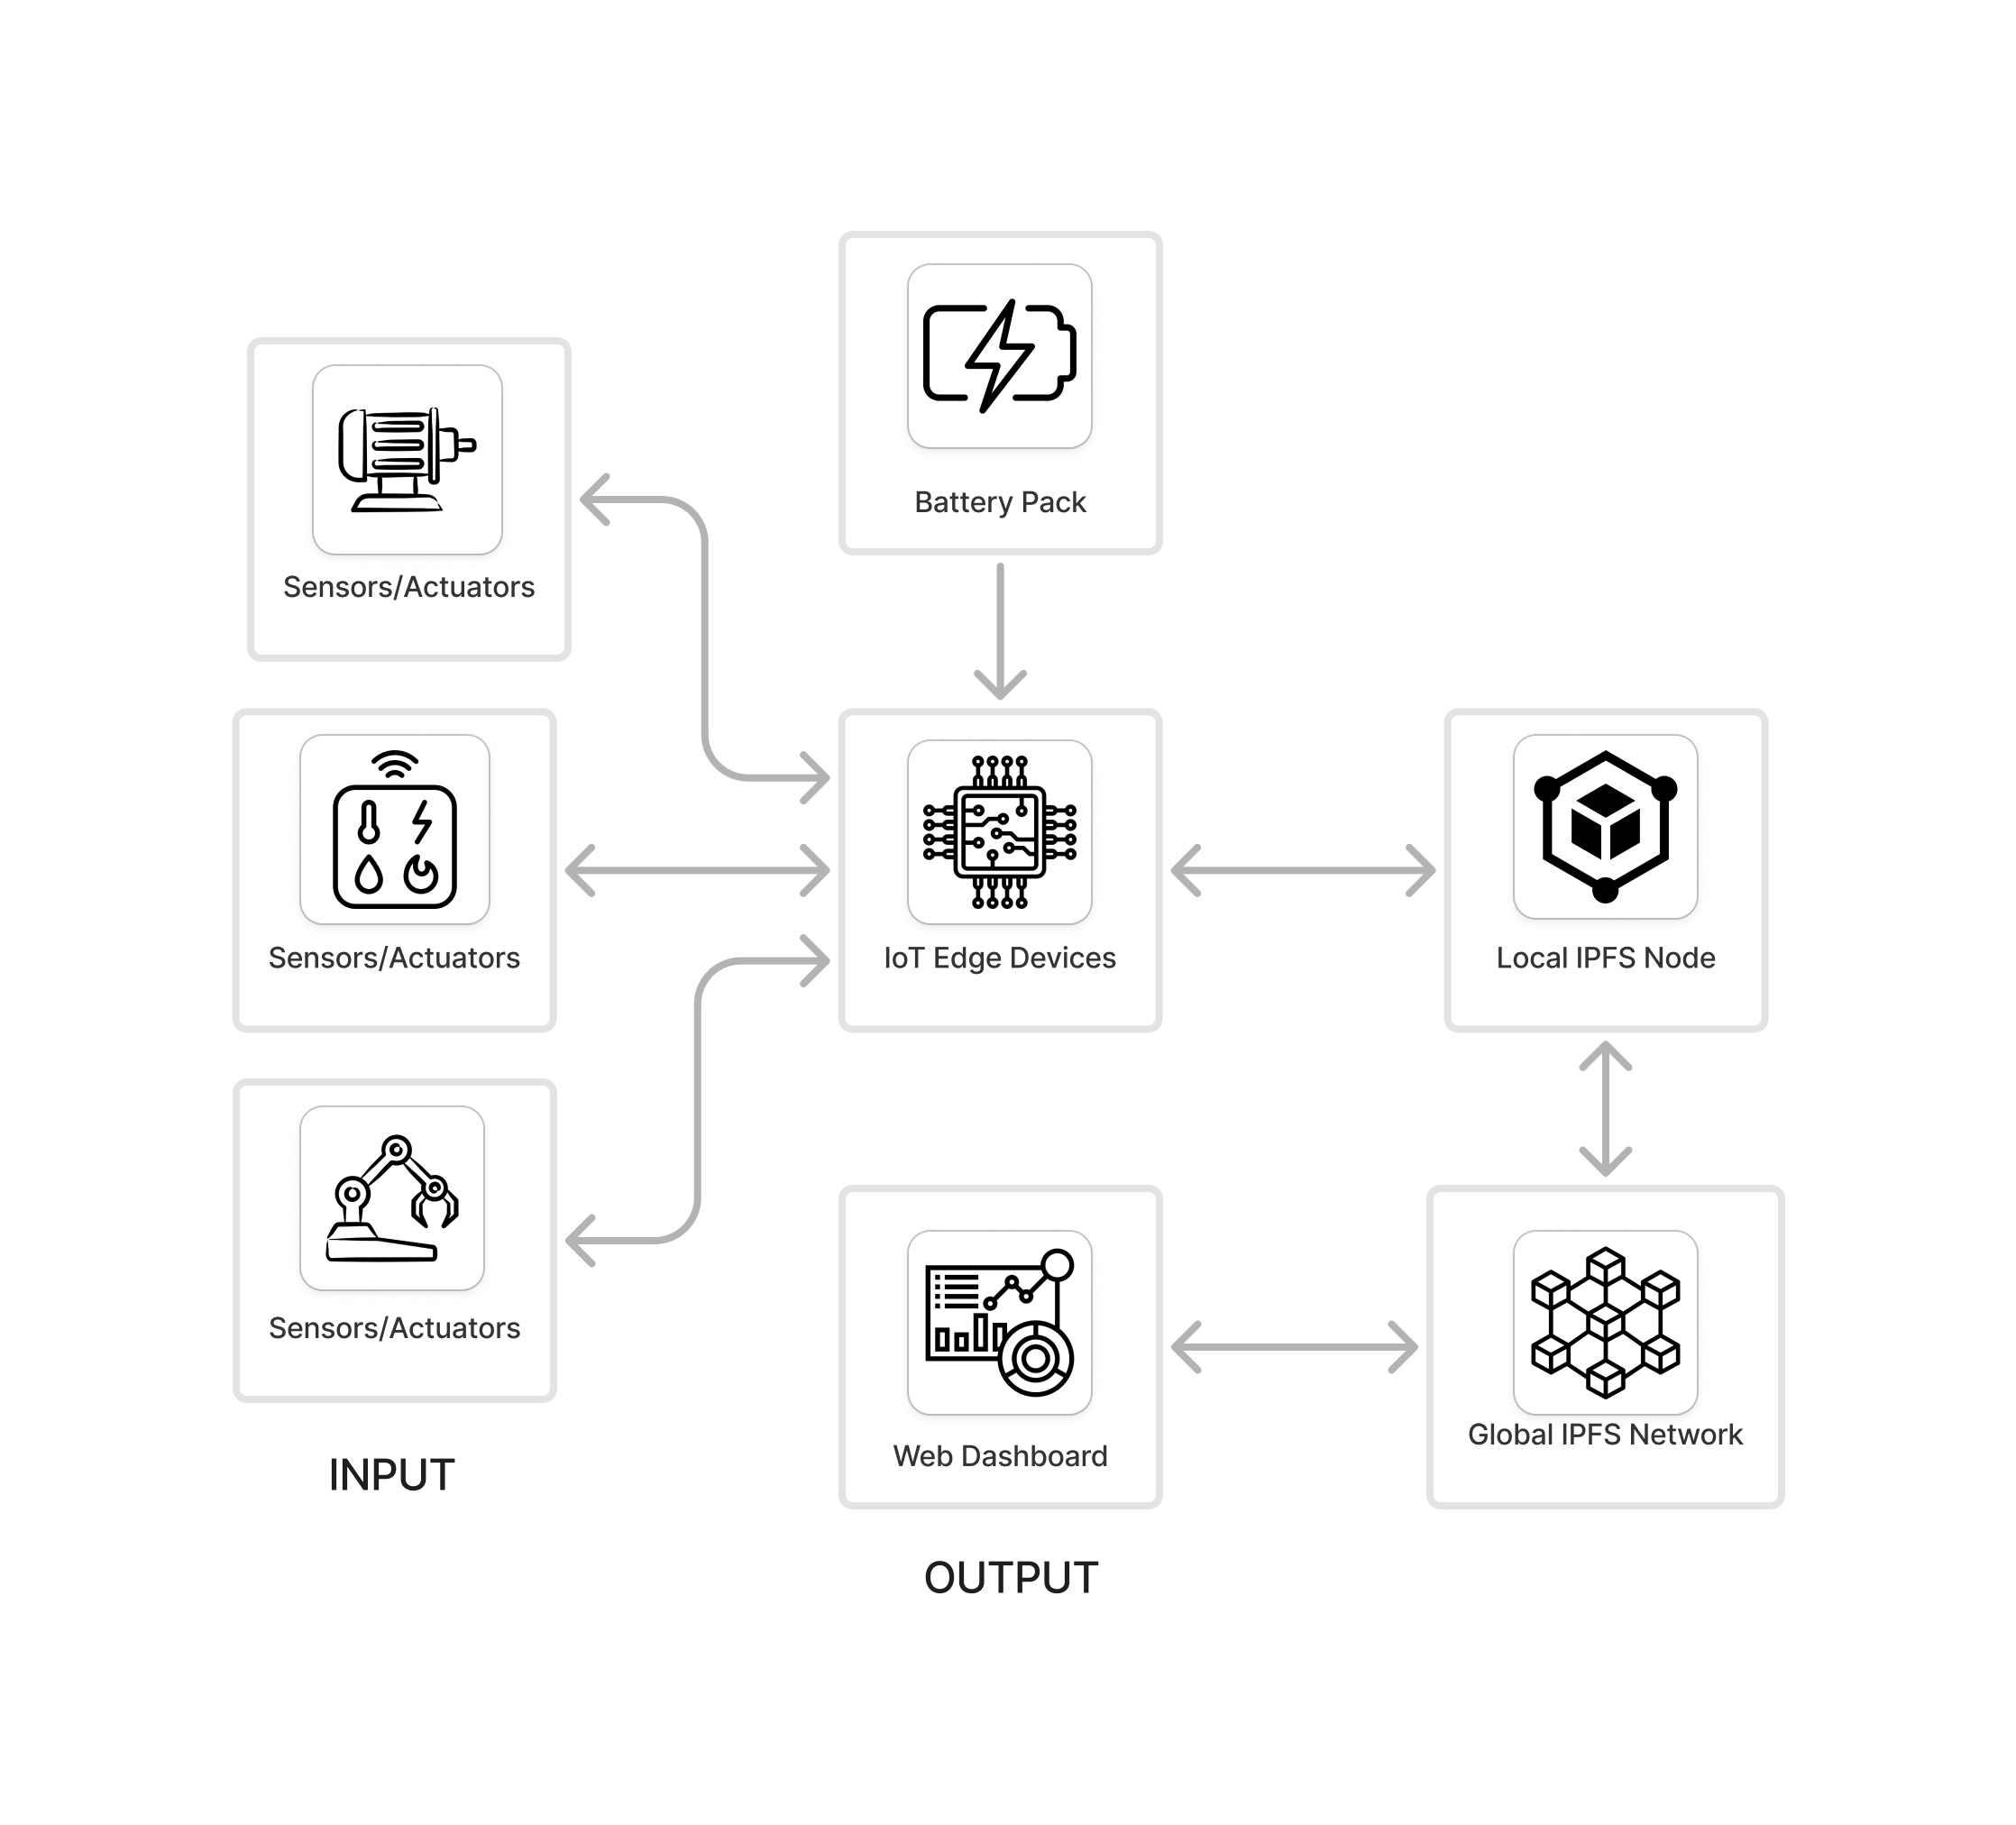
Architecture Diagram

Slide 9
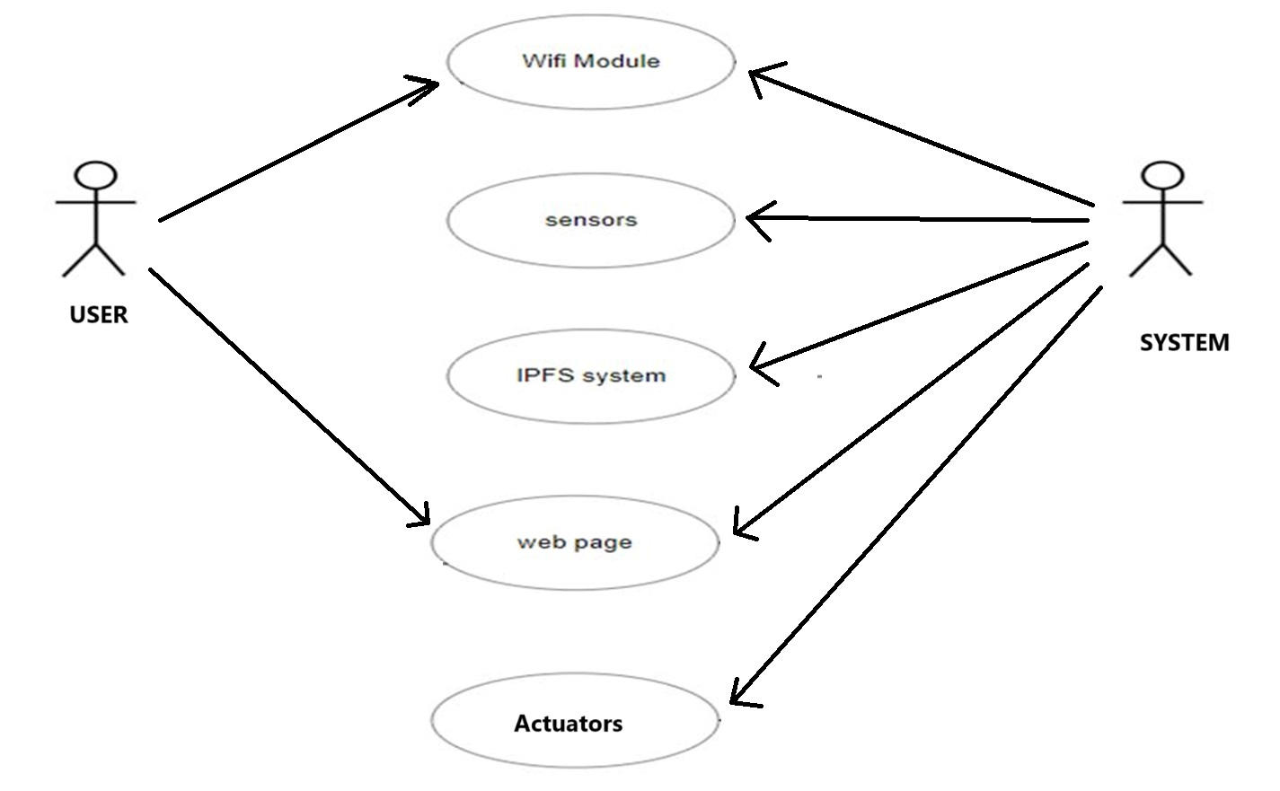
Use Case Diagram
DEVICE

Slide 10
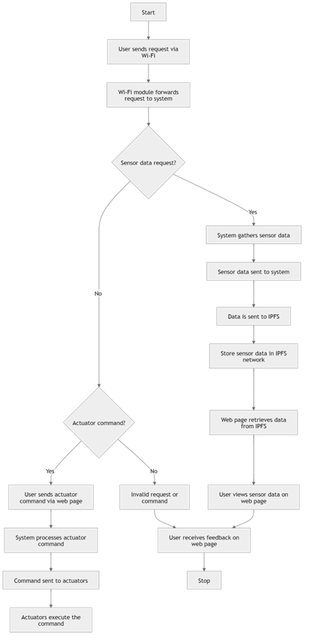
ACTIVITY DIAGRAM

Slide 11
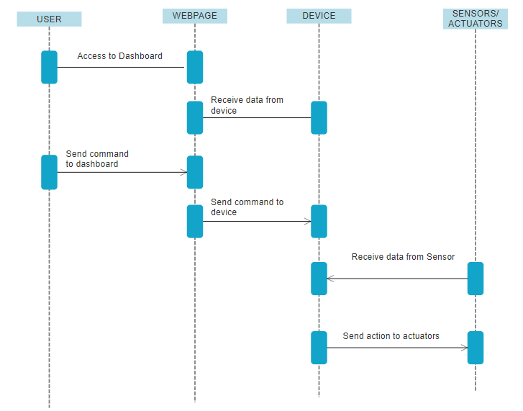
SEQUENCE DIAGRAM

Slide 12
Requirement Analysis
SOFTWARE REQUIRMENT:
WINDOWS/LINUX
IDE EDITOR
IPFS DESKTOP
COMMAND SHELL
HARDWARE REQUIRMENT:
MICROPROCESSOR (Rpi,ESP32,Arduino UNO)
SENSORS
ACTUATORS
POWER PACK

Slide 13
MODULES/METHODOLOGY
IOT DEVICE MANAGEMENT MODULE
BLOCKCHAIN INTEGRATION MODULE
IPFS DATA STORAGE MODULE
DEVICE AUTHENTICATION AND SECURITY MODULE
USER INTERFACE AND DASHBOARD MODULE

Slide 14
Feasibility Study
Technical Feasibility: Most microcontrollers (e.g., Arduino, Raspberry Pi, ESP8266/ESP32) can be easily programmed to interface with serial communication for receiving commands. Local IPFS Node: Running a local IPFS node on a computer is technically feasible with minimal resource requirements. IPFS has mature libraries for Python, making it easy to interact with the network.
Operational Feasibility: The system requires regular monitoring to ensure the IPFS node is running and the microcontroller is functioning correctly. The project can be implemented with minimal setup. The most time-consuming part may be setting up the IPFS node and ensuring it communicates effectively with the microcontroller.
Economic Feasibility: The project is technically and economically feasible with minimal costs and development time. It provides a valuable learning experience in combining IoT with decentralized technologies like IPFS.

Slide 15
Scope of the Project
Develop a scalable and efficient IoT data management system using IPFS.
Ensure secure and reliable storage of IoT data.
Enable seamless data sharing and analysis between IoT devices.
Provide a decentralized and privacy-preserving solution for IoT applications.

Slide 16
Conclusion
In conclusion, this project demonstrates the transformative potential of integrating the Interplanetary File System (IPFS) with the Internet of Things (IoT) for home automation. By addressing some of the critical limitations present in traditional, centralized IoT architectures, such as privacy concerns, scalability issues, and vulnerability to single points of failure, IPFS offers a decentralized and more secure framework for IoT communication. In the context of home automation, where the interconnectedness of devices plays a crucial role in enhancing the efficiency, security, and functionality of smart homes, the decentralized model proves particularly advantageous.

Slide 17
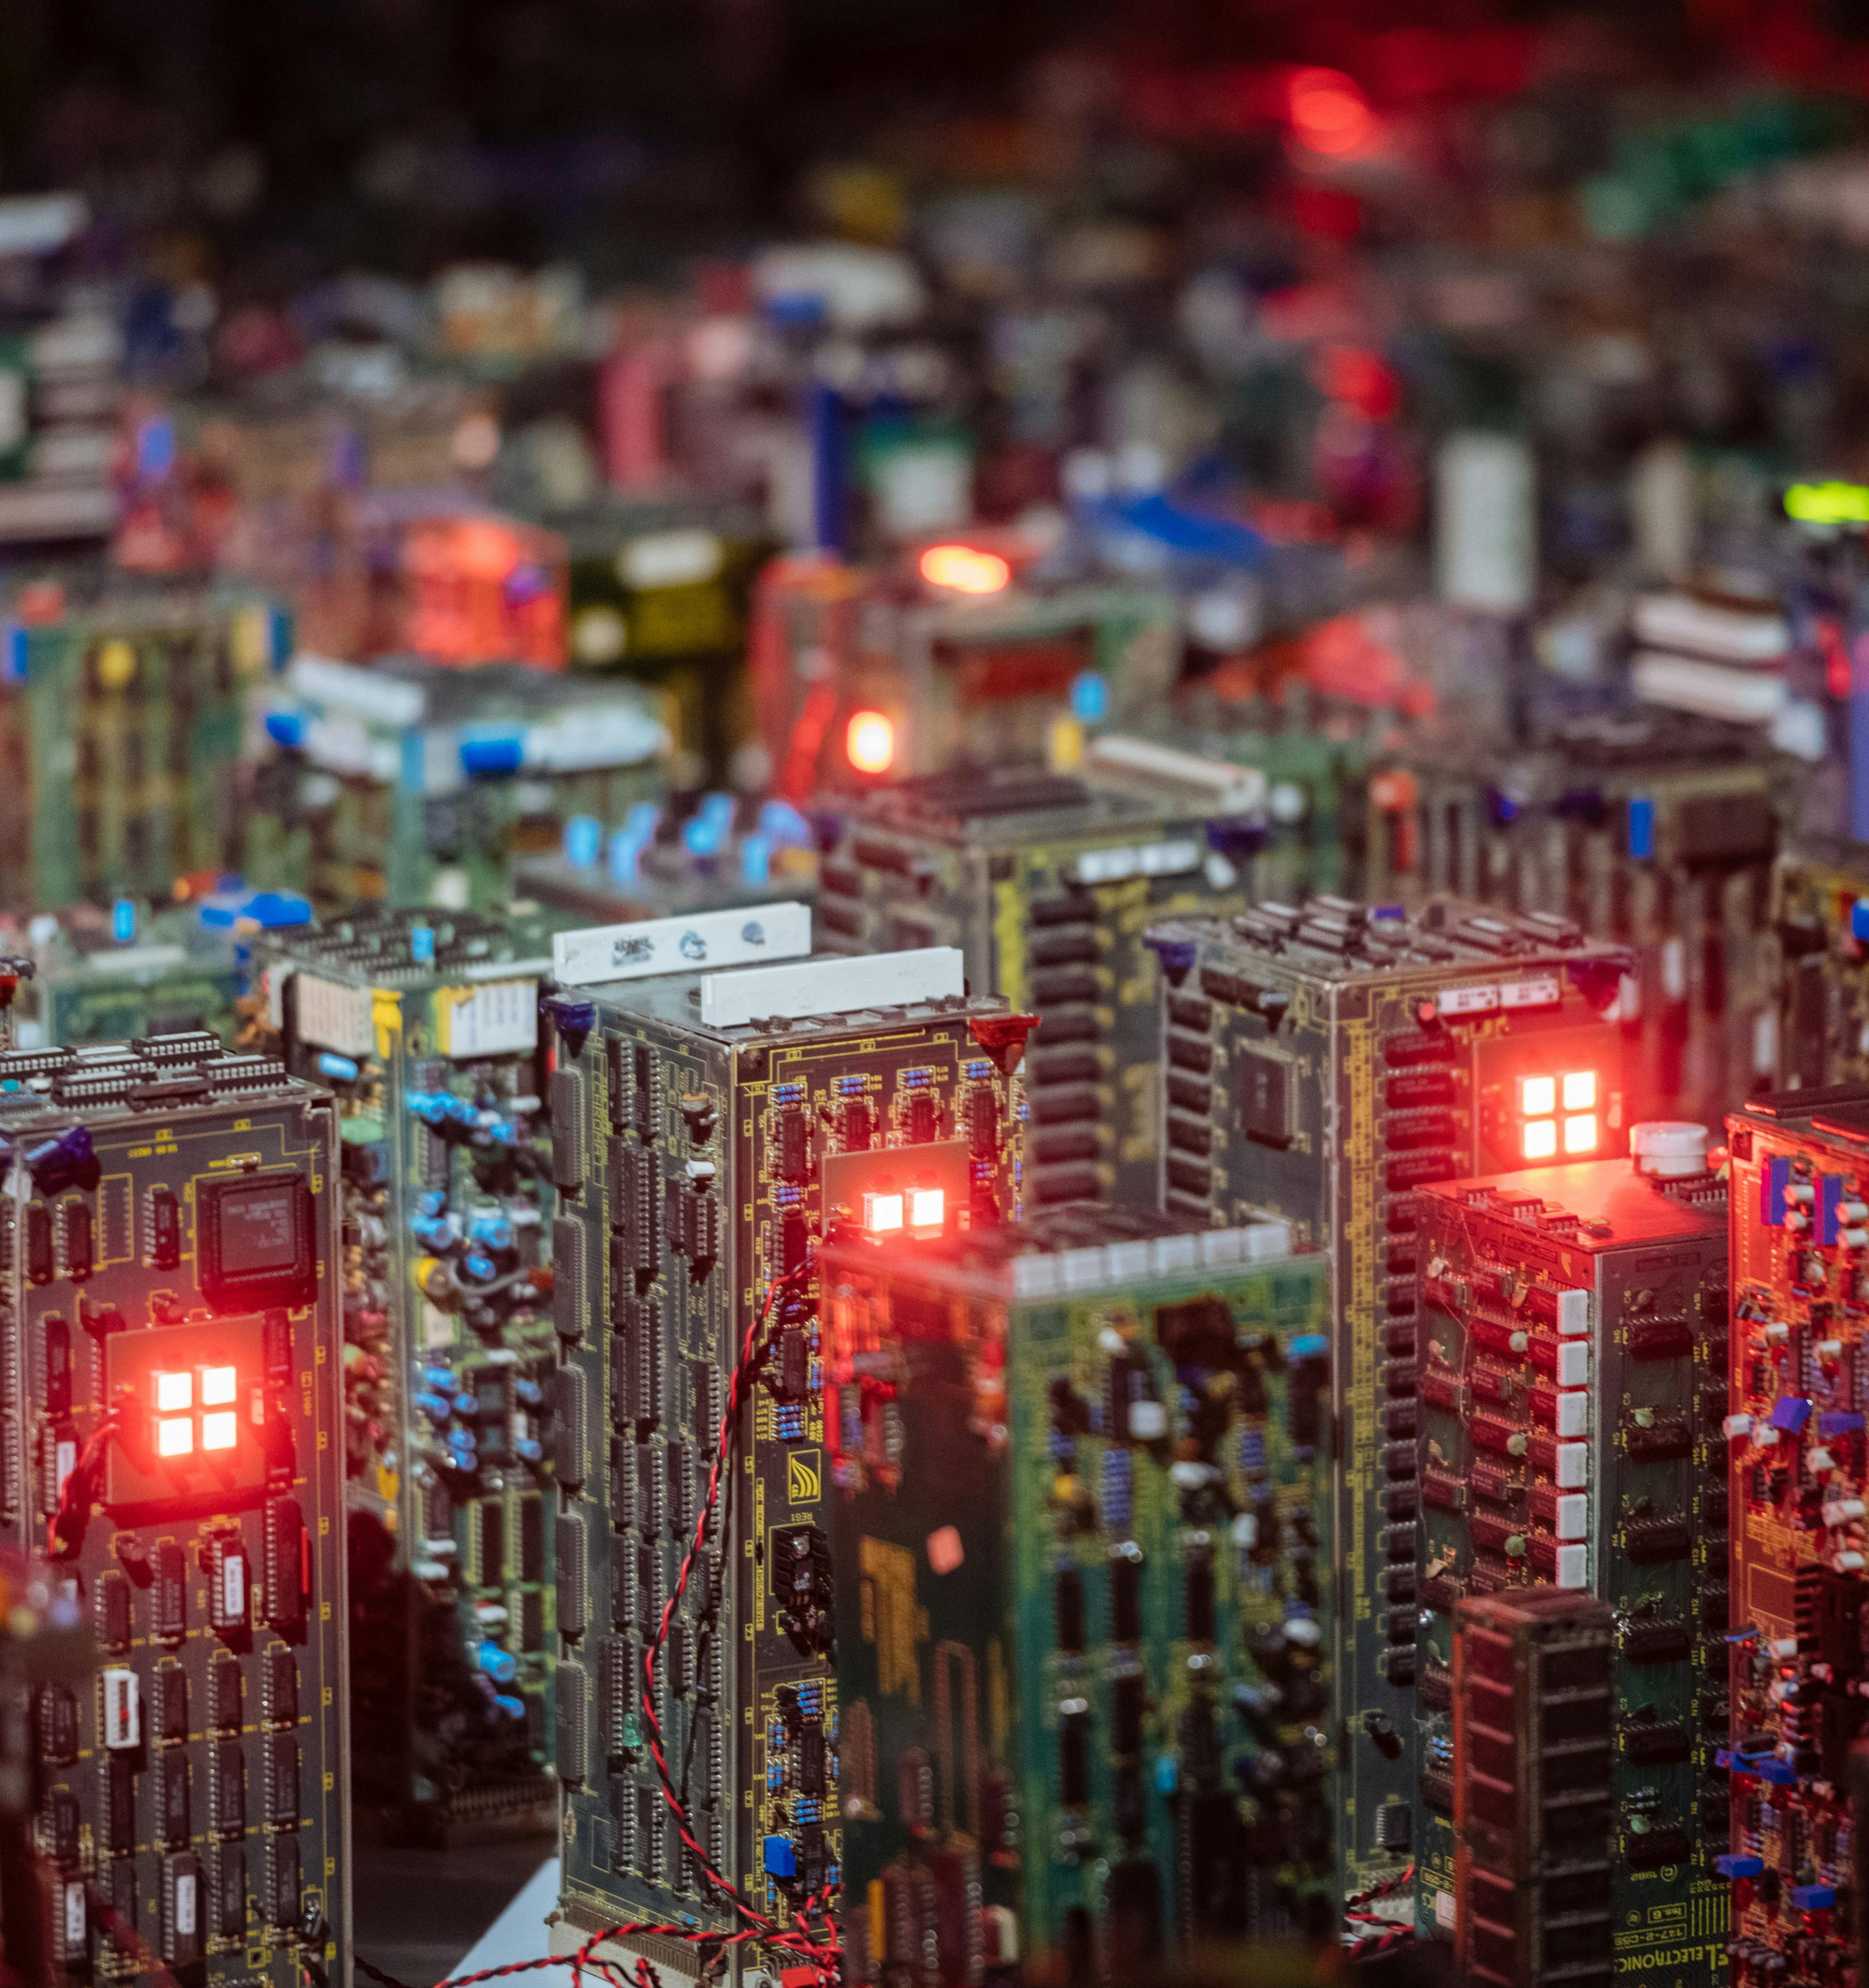
Thank you

